Slide 1
Memory Management in Programming Languages
Lecture # 5

Slide 2
What is Memory management?
Memory management is the process of controlling and coordinating the way a software application access computer memory
When a software runs on a target Operating system on a computer it needs access to the computers RAM(Random-access memory) to:
load its own bytecode that needs to be executed
store the data values and data structures used by the program that is executed
load any run-time systems that are required for the program to execute

Slide 3
Review Definitions
Method: any subprogram (function, procedure, subroutine) – depends on language terminology.
Environment of an active method: the variables it can currently access plus their addresses (a set of ordered pairs)
State of an active method: variable/value pairs

Slide 4
Three Categories of Memory (for Data Store)
Static: storage requirements are known prior to run time; lifetime is the entire program execution
Run-time stack: memory associated with active functions
Structured as stack frames (activation records)
Heap: dynamically allocated storage; the least organized and most dynamic storage area

Slide 5
Static Data Memory
Simplest type of memory to manage.
Consists of anything that can be completely determined at compile time; e.g., global variables, constants (perhaps), code.
Characteristics:
Storage requirements known prior to execution
Size of static storage area is constant throughout execution

Slide 6
Run-Time Stack
The stack is a contiguous memory region that grows and shrinks as a program runs.
Its purpose: to support method calls
It grows (storage is allocated) when the activation record (or stack frame) is pushed on the stack at the time a method is called (activated).
It shrinks when the method terminates and storage is de-allocated.

Slide 7
Run-Time Stack
The stack frame has storage for local variables, parameters, and return linkage.
The size and structure of a stack frame is known at compile time, but actual contents and time of allocation is unknown until runtime.
How is variable lifetime affected by stack management techniques?

Slide 8
Heap Memory
Heap objects are allocated/deallocated dynamically as the program runs (not associated with specific event such as function entry/exit).
The kind of data found on the heap depends on the language
Strings, dynamic arrays, objects, and linked structures are typically located here.
Java and C/C++ have different policies.

Slide 9
Heap Memory
Special operations (e.g., malloc, new) may be needed to allocate heap storage.
When a program deallocates storage (free, delete) the space is returned to the heap to be re-used.
Space is allocated in variable sized blocks, so deallocation may leave “holes” in the heap (fragmentation).
Compare to deallocation of stack storage

Slide 10
Heap Management
Some languages (e.g. C, C++) leave heap storage deallocation to the programmer
delete
Others (e.g., Java, Perl, Python, list-processing languages) employ garbage collection to reclaim unused heap space.

Slide 11
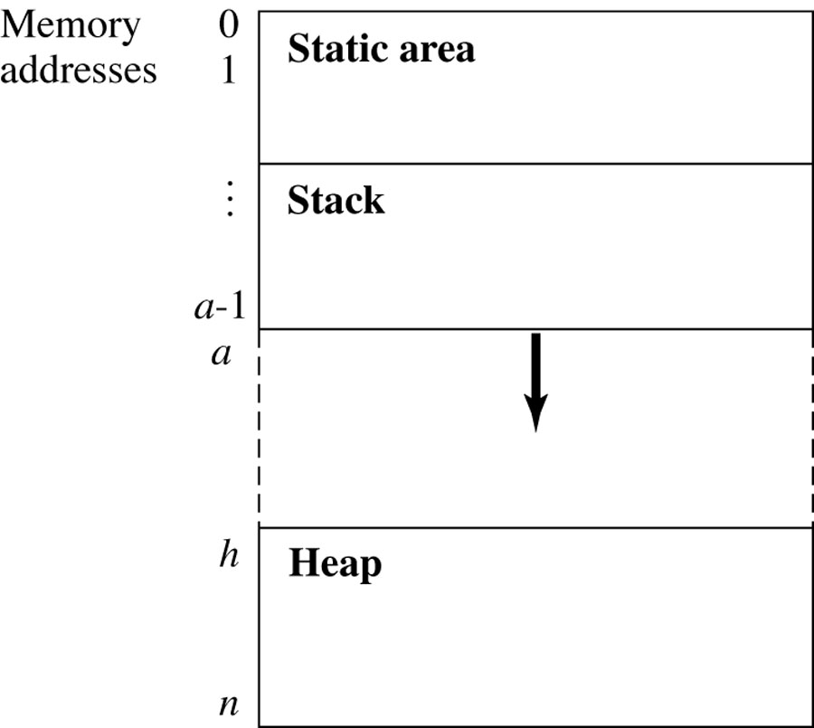
The Structure of Run-Time Memory
Figure 11.1
These two areas grow towards each other as program events require.

Slide 12
Stack Overflow
The following relation must hold: 0 ≤ a ≤ h ≤ n
In other words, if the stack top bumps into the heap, or if the beginning of the heap is greater than the end, there are problems!

Slide 13
Array out-of-bounds violations in C
No run-time type-checking is taking place as a C program executes.
No-one is tracking array bounds violations

Slide 14
Heap Storage States
For simplicity, we assume that memory words in the heap have one of three states:
Unused: not allocated to the program yet
Undef: allocated, but not yet assigned a value by the program
Contains some actual value

Slide 15
Heap Management Functions
new returns the start address of a block of k words of unused heap storage and changes the state of the words from unused to undef.
n ≤ k, where n is the number of words of storage needed; e.g., suppose a Java class Point has data members x,y,z which are floats.
If floats require 4 bytes of storage, then Point firstCoord = new Point( ) calls for 3 X 4 bytes (at least) to be allocated and initialized to some predetermined state.

Slide 16
Heap Overflow
Heap overflow occurs when a call to new occurs and the heap does not have a contiguous block of k unused words
So new either fails, in the case of heap overflow, or returns a pointer to the new block

Slide 17
Heap Management Functions
delete returns a block of storage to the heap
The status of the returned words are returned to unused, and are available to be allocated in response to a future new call.
One cause of heap overflow is a failure on the part of the program to return unused storage.

Slide 18
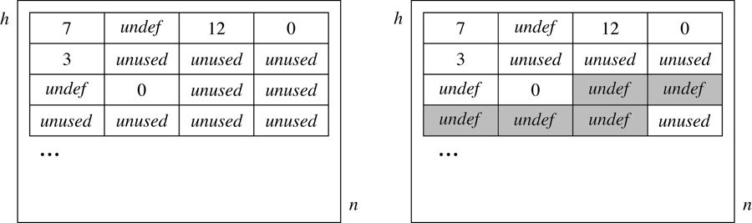
The New (5) Heap Allocation Function Call: Before and After
A before and after view of the heap. The “after” shows the affect of an operation requesting a size-5 block. (Note difference between “undef” and “unused”.) Deallocation reverses the process.

Slide 19
Heap Allocation
Heap space isn’t necessarily allocated and deallocated from one end (like the stack) because the memory is not allocated and deallocated in a predictable (first-in, first-out or last-in, first-out) order.
As a result, the location of the specific memory cells depends on what is available at the time of the request.

Slide 20
Memory Attributes
Memory to store data in programming languages has the following lifecycle
Allocation: When the memory is allocated to the program
Lifetime: How long allocated memory is used by the program
Recovery: When the system recovers the memory for reuse

Slide 21
Memory Classes
Static memory – Usually at a fixed address
Lifetime – The execution of program
Allocation – For entire execution
Recovery – By system when program terminates
Allocator – Compiler
Automatic (LIFO) memory – Usually on a stack
Lifetime – Activation of method using that data
Allocation – When method is invoked
Recovery – When method terminates
Allocator – Typically compiler, sometimes programmer

Slide 22
Memory Classes …cont
Dynamic memory – Addresses allocated on demand in an area called the heap
Lifetime – As long as memory is needed
Allocation – Explicitly by programmer, or implicitly by compiler
Recovery – Either by programmer or automatically (when possible and depends upon language)
Allocator – Manages free/available space in heap

Slide 23
Memory Management in C
Local variables live on the stack
Allocated at function invocation time
Deallocated when function returns
Storage space reused after function returns
Space on the heap allocated with malloc()
Must be explicitly freed with free()
Called explicit or manual memory management
Deletions must be done by the user

Slide 24
Memory Management
Computer programs need to allocate memory to store data values and data structures.
Memory is also used to store the program itself and the run-time system needed to support it.
If a program allocates memory and never frees it, and that program runs for a sufficiently long time, eventually it will run out of memory.
Even in the presence of virtual memory, memory consumption is still a major issue because it is considerably less efficient to access virtual memory than to access physical memory

Slide 25
Manual & Automatic Memory Management
Automatic memory management
Which ask the programmer to allocate and free memory manually.
The C language requires the programmer to implement memory management each time, for each application program.
Modern programming languages such as Java, C#, Caml, Cyclone and Ruby provide automatic memory management with garbage collection

Slide 26
Manual Memory Management
In C, where there is no garbage collector, the programmer must allocate and free memory explicitly.
The key functions are malloc and free.
The malloc function takes as a parameter the size in bytes of the memory area to be allocated.
The size of a type can be obtained using sizeof.
The resulting area of memory does not represent a value of the correct type, so it then needs to be cast to the correct type.

Slide 27
Dangling Pointer Problem
A significant problem with manual memory management is that it is possible to attempt to use a pointer after it has been freed.
This is known as the dangling pointer problem. Dangling pointer errors can arise whenever there is an error in the control flow logic of a program.
This can lead to allocation, use and deallocation happening in the wrong order in some circumstances
Use before allocation may be a fatal run-time error. Use after deallocation is not always fatal. Neither of these is a good thing.

Slide 28
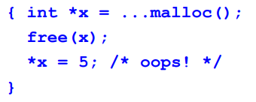
Dangling Pointer

Slide 29
Space/MEMORY Leak
Another potential problem of manual memory management is not remembering to free allocated memory when it should be freed.
The reference to an allocated area of memory can be lost when a variable in a block-structured language goes out of scope.
This problem is perhaps more subtle than the dangling pointer problem because it may only become manifest for long-running applications.
When memory is lost and cannot be reclaimed we term this a space leak. Space cannot be lost forever without reaching the limit on the available memory.
sA long-running program with a space leak will eventually crash.

Slide 30
MEMORY LEAK

Slide 31
May free something twice

Slide 32
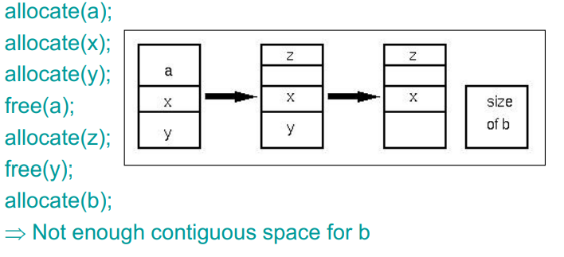
Fragmentation
Another memory management problem
Example sequence of calls

Slide 33
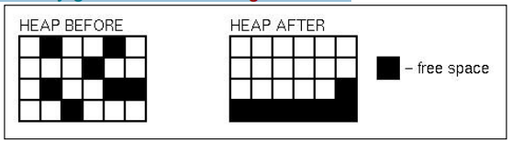
Automatic Memory management
Primary goal: automatically reclaim dynamic memory.
Secondary goal: also avoid fragmentation

